Slide 1




Venezuelan Humanitarian Emergency
Main Epidemics & Mortality

Slide 2
Public Health Emergency of International Concern (PHEIC)
A PHEIC is an extraordinary event with public health risk to other countries that requires a coordinated international response.
In Venezuela, the legal criteria for a PHEIC has been met. The Venezuelan Humanitarian Emergency is affecting the entire region.
The International Health Regulations (2005) (IHR) empowered the WHO Director-General to declare a PHEIC.
  IHR criteria include: public health impact, novelty and scale, and movement of persons.
  Impact= Measles/Diphtheria | Scale= Malaria | Movement = >3.5 M migrants

Slide 3
Venezuelan Main Epidemics
Cases
2010 vs. 2018*
Deaths cumulative
2010 – 2018*
Measles
Diphtheria
HIV
TB
Malaria
Pertusis
0 – >6K
0 – >1K
97K – >120K
6K – 11K
45K – >1 M
?
>76
>270
>25K
>7K
>1K
?
Hepatitis & Diarrhea
?
?
Source: PAHO/WHO, World Bank, Venezuelan MOH, others. *Best available information.

Slide 4
Stocks of Venezuelan population in the region, Sep 2018
Migration
> 3 M migrants
>5.3 M
Expected by the end of 2019
Source: Regional Interagency Coordination Platform, UNHCR.

Slide 5
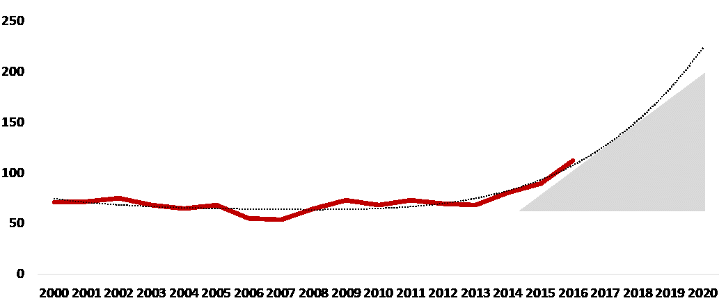
Maternal Mortality Rate
Excess
Mortality
No. x 100,000 live births
Source: Venezuelan MOH (published & unpublished).

Slide 6
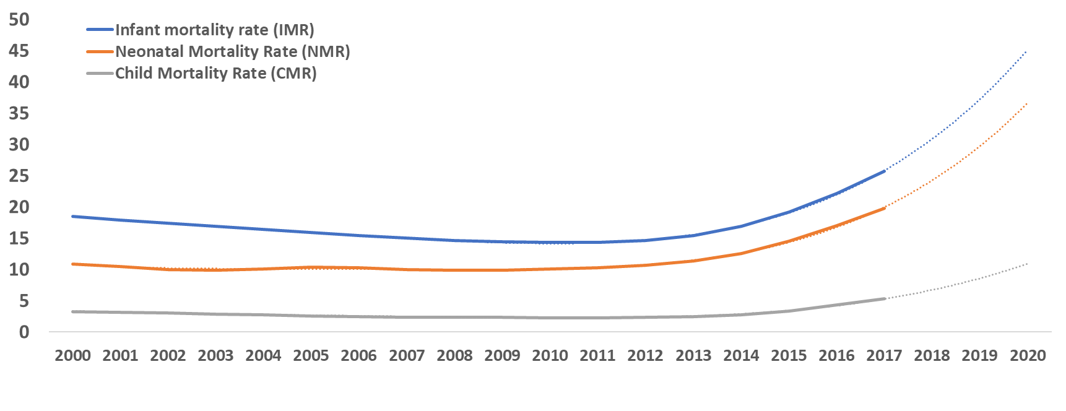
Neonatal, Infant and Child Mortality Rates
Excess Mortality
No. x 1,000 live births
UN Inter-agency Group for Child Mortality Estimation (UN IGME) in 2018
Source: UN Inter-agency Group for Child Mortality Estimation (UN IGME).

Slide 7
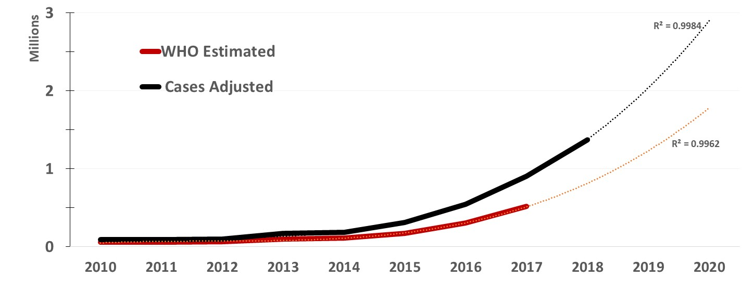
Malaria cases in Venezuela 2010-2018
Source: WHO Malaria Report 2018, Venezuelan MPPPS, AVS, ASOCIS, GDO.

Slide 8
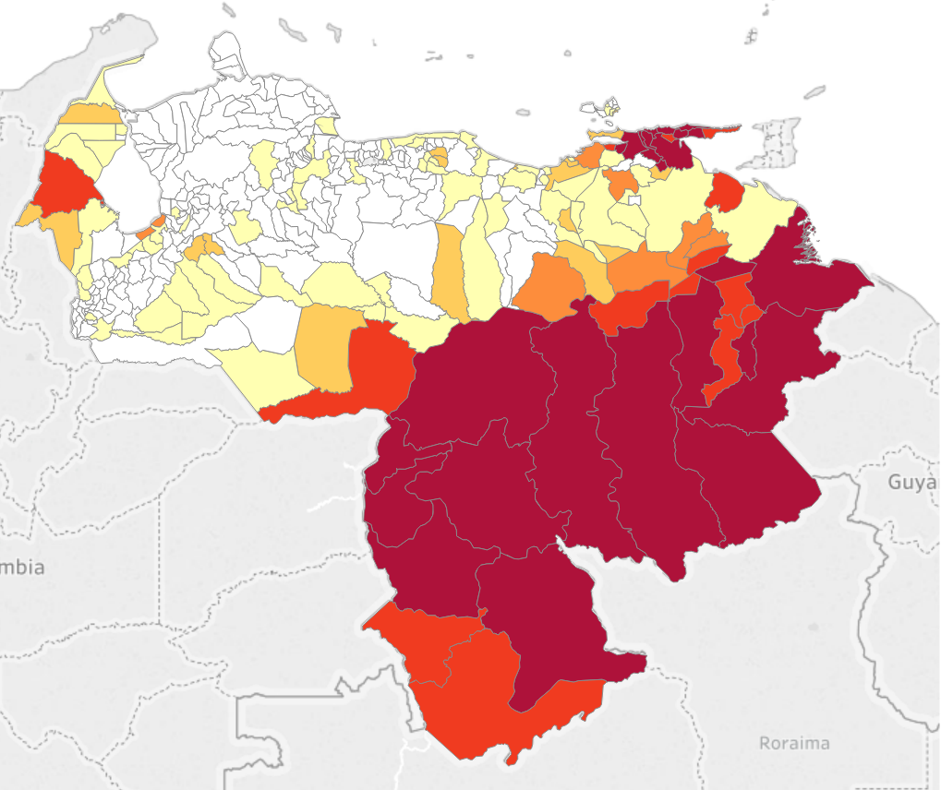

Malaria
Malaria Incidence Map 2017
2017
States: 13/23
Municipalities: 62
Parishes: 123
2018*
States: 22/23 + DC
Municipalities: 165
Parishes: 381
Source: Venezuelan MOH (unpublished), *SE 40, 2018, PAHO/WHO.

Slide 9
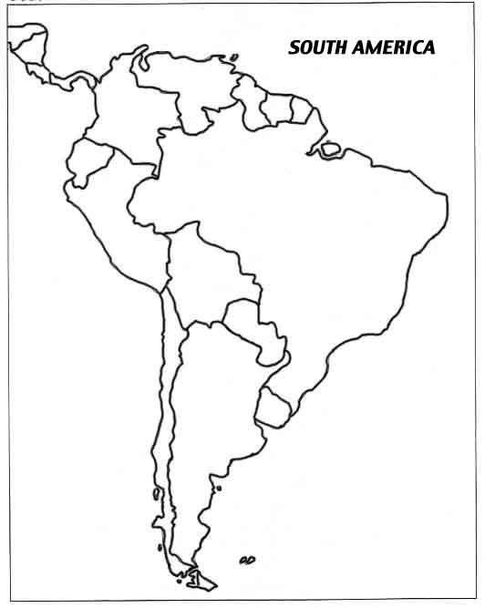
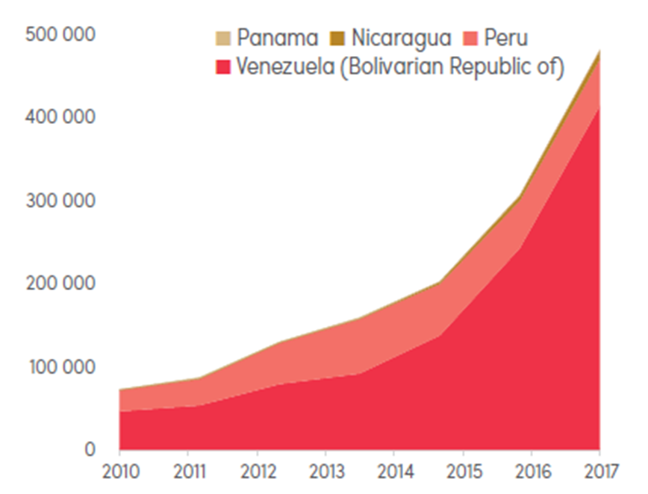
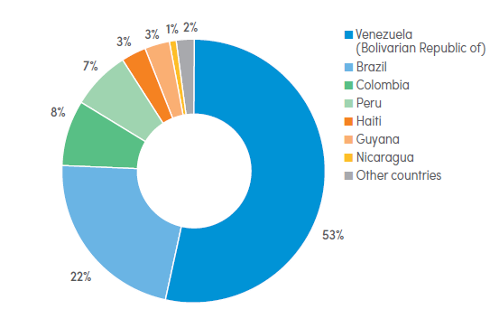
Malaria spread in the region, 2018
Malaria
32 T&T
1684
Share of estimated cases, 2017
Countries with increased 2010-2017
23
4641
22
3
10
Source: World Malaria Report 2018, Countries National Surveillance systems.

Slide 10
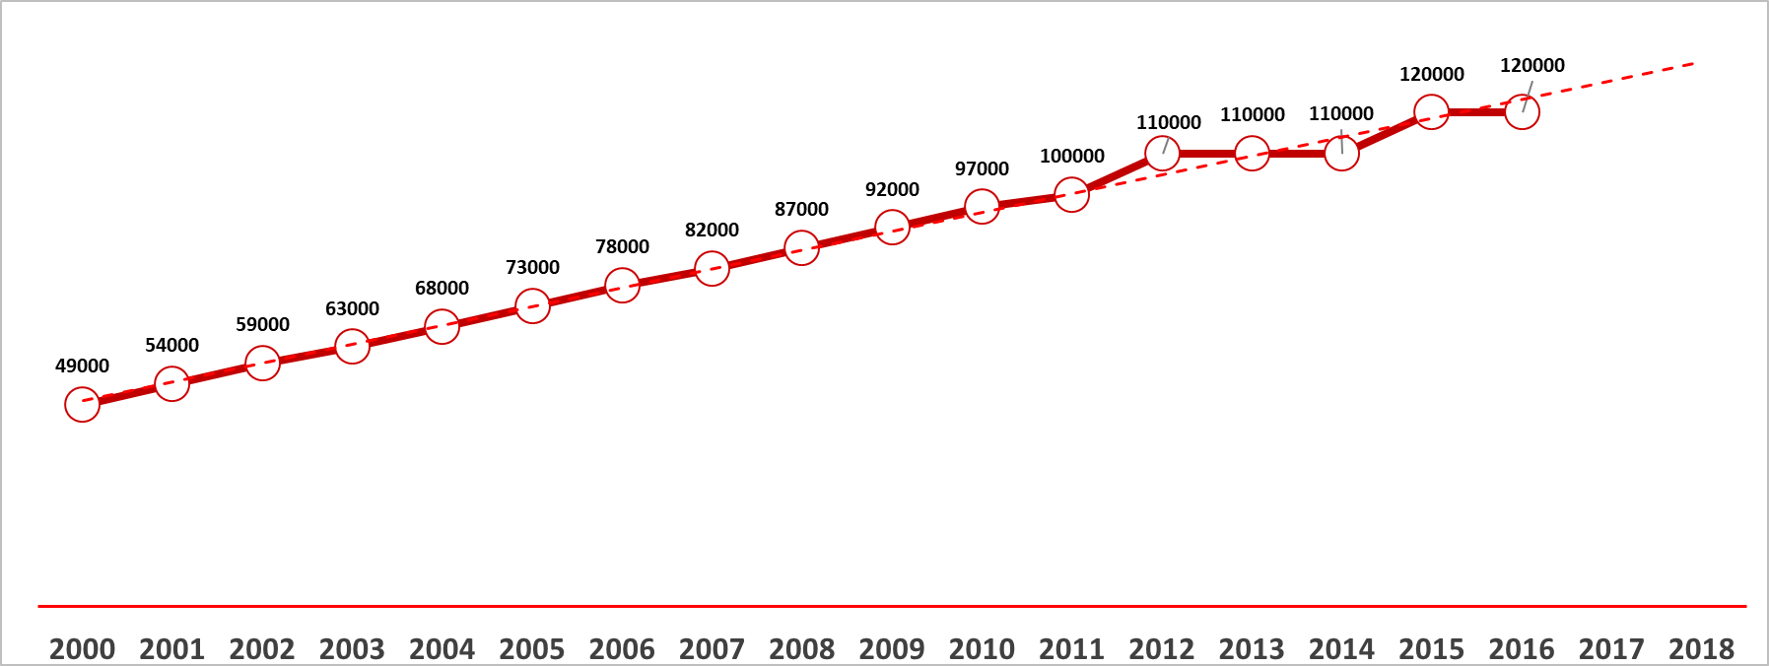
HIV
People living with HIV
Viral suppression 7%
Source: UNAIDS.

Slide 11
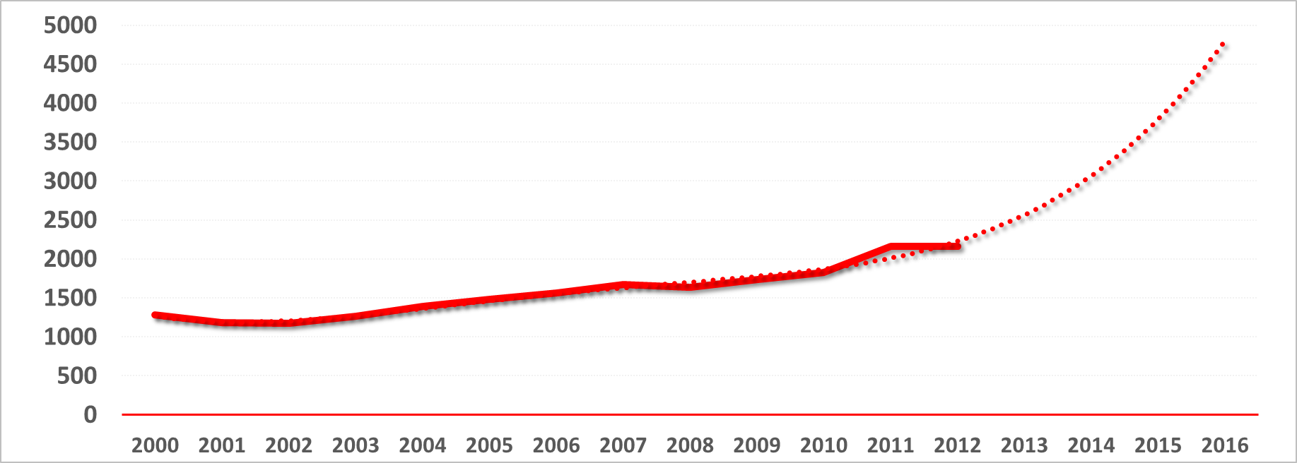
HIV
HIV-related Deaths
Source: Venezuelan MOH.

Slide 12
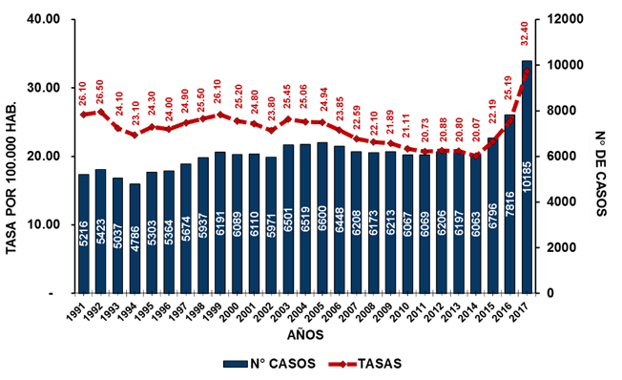
Tuberculosis
No. Cases
Incidence per 100,000
Source: Venezuelan MOH (Unpublished), Master Plan HIV-TB-Malaria.

Slide 13
Urgently, governments and all civil society organizations must call upon the WHO Director-General to reconvene the Emergency Committee to review the grounds for a PHEIC declaration in Venezuela.

Slide 14
Contact list
ASOCIS | Asociación Civil Impacto Social | asocisven@gmail.com
AVS | Alianza Venezolana para la Salud | alianzavsalud@gmail.com
SVSP |Sociedad Venezolana de Salud Pública saulpena09@gmail.com
GDO | Global Development One | LVillegas@gdoassociates.com
ICASO | International Council for AIDS Service Organizations | maryannt@icaso.org

